Slide 1

Forecasting Airline Ticket Prices

Slide 2






TEAM 9
Mohammed Khaja Mujahiddin
TEAM LEAD
Sana Tabassum Shaik
DATA SCIENTIST
Sai Deepak Reddy Katam
STORY TELLING AND VISUALIZATION

Slide 3

INTRODUCTION
The airline sector plays a vital role in the worldwide travel and transportation industry.
It involves the purchase and sale of airline tickets for passenger travel, spanning both domestic and international routes.
Travelers seek the most favorable offers while airlines aim to maximize profits through ticket sales.
As the industry progresses, developing a model to predict flight ticket prices will prove invaluable for both travelers and airlines. Such models can aid consumers in finding optimal deals while assisting airlines in refining their pricing strategies.

Slide 4
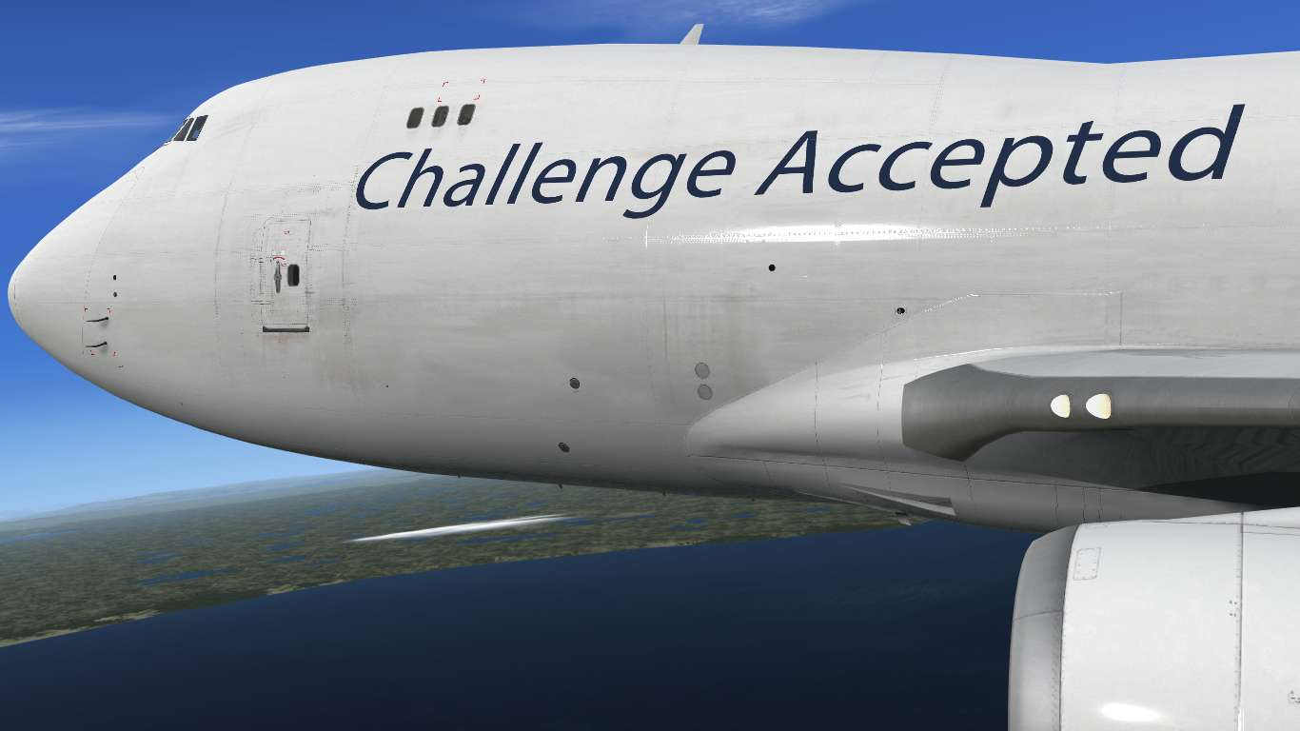
Challenge
What methods can be used to forecast the cost of an airline ticket using specific characteristics?
Many factors affect airline ticket rates, making them a complex and ever-changing pricing challenge. Using the capabilities of data and machine learning, we can construct models that accurately predict fare prices .These models are flexible enough to adjust to shifting market conditions as the business develops, which eventually helps both passengers and airlines.

Slide 5

Solution
Applications of data science and machine learning are found in many different fields and sectors of the economy .These technologies could improve productivity and decision-making by automating tasks, producing forecasts, and extracting insightful information.
Forecasting airline ticket prices presents a complex challenge, requiring consideration of numerous variables and factors. Utilizing data science and machine learning techniques offers an effective approach to developing solutions for predicting airline ticket fares

Slide 6
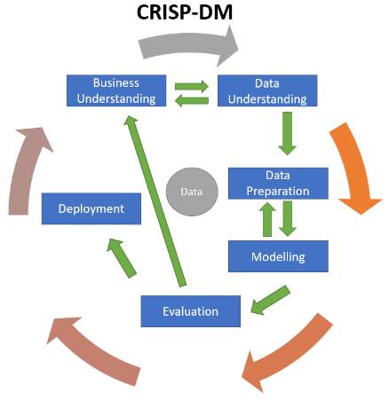
USER STORY
SERVER END WORK
Sub Goal
take in the specifications of the customer and process them to find the solution that meets all or maximum of the specifications
User Story
As a User, I should be able to book a flight ticket that meets all my requirements
Main Goal
To suggest a flight ticket to the customer
Business Goal
Product

Slide 7


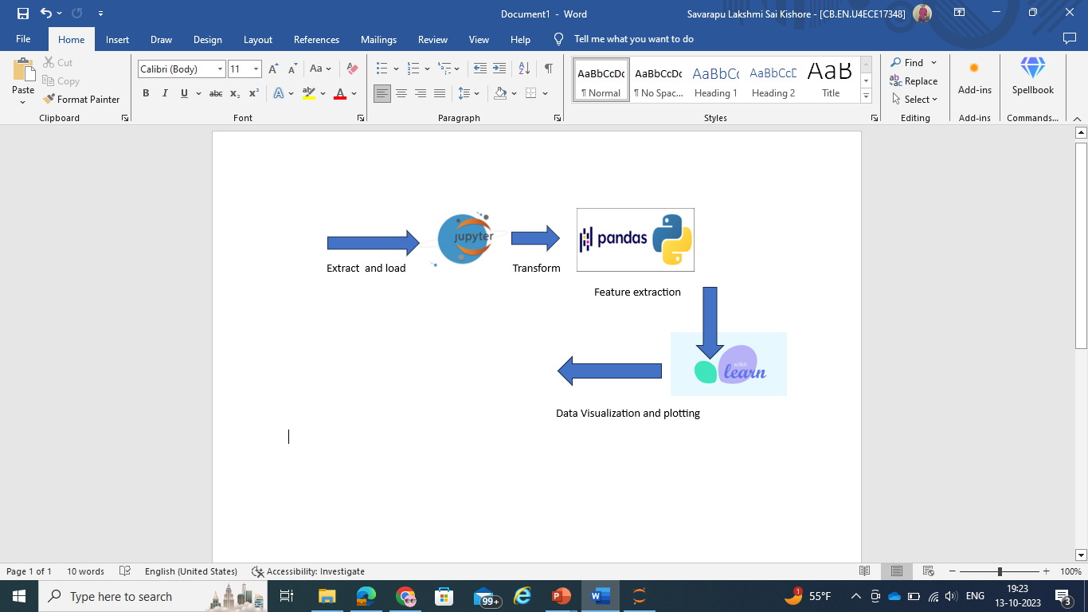

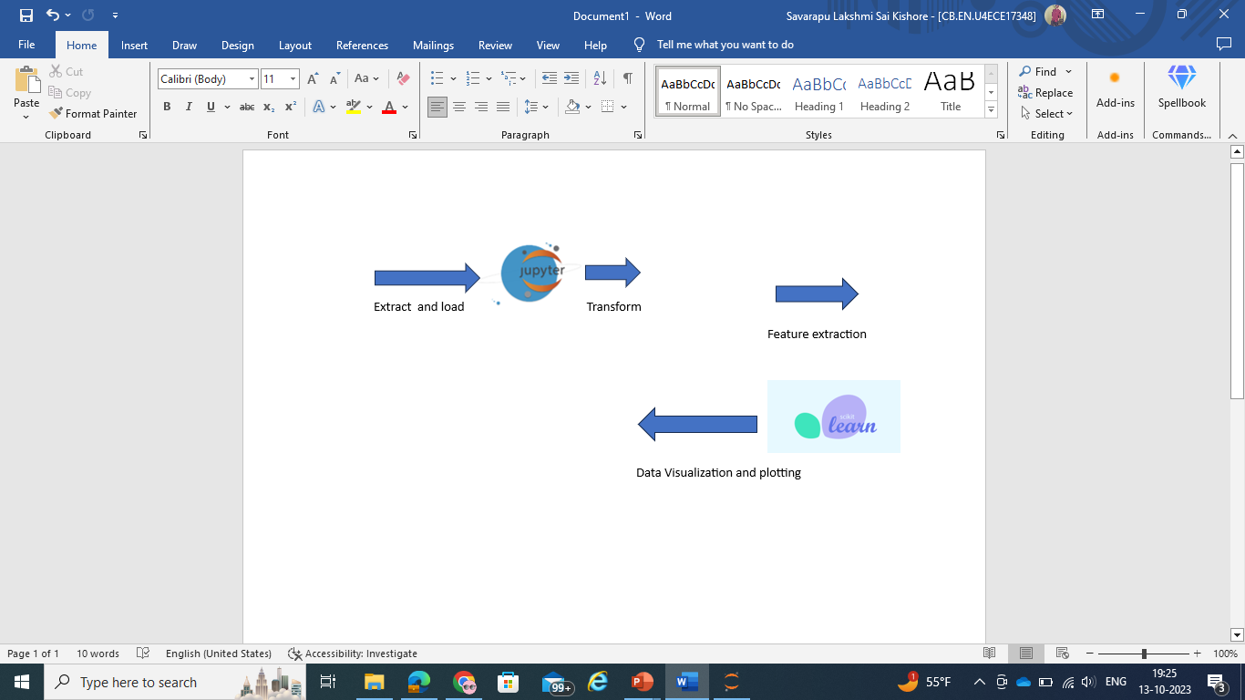

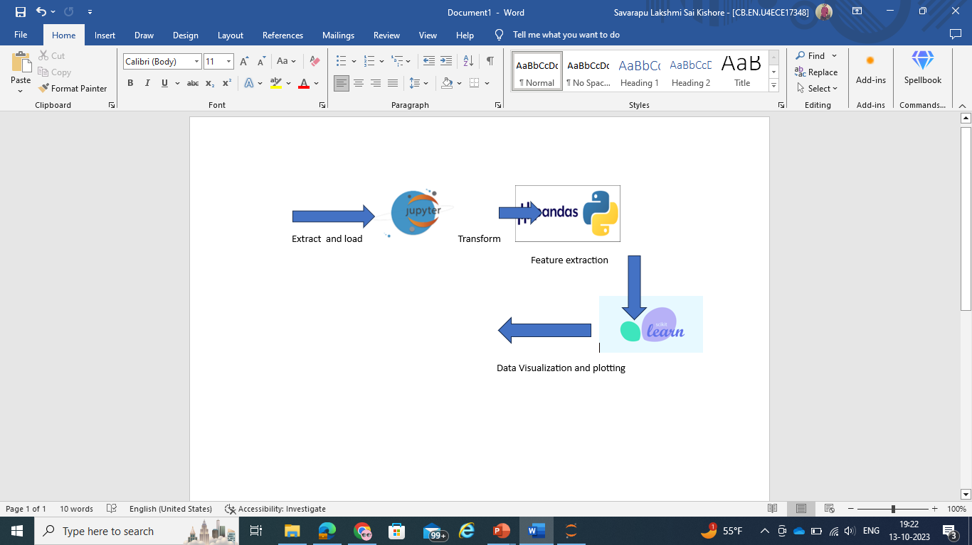
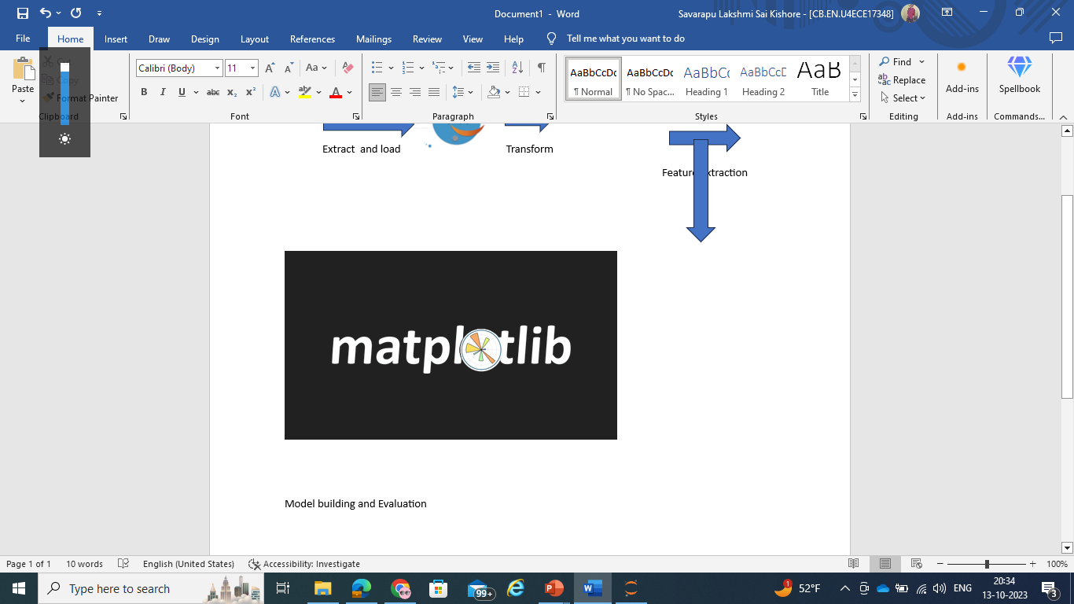

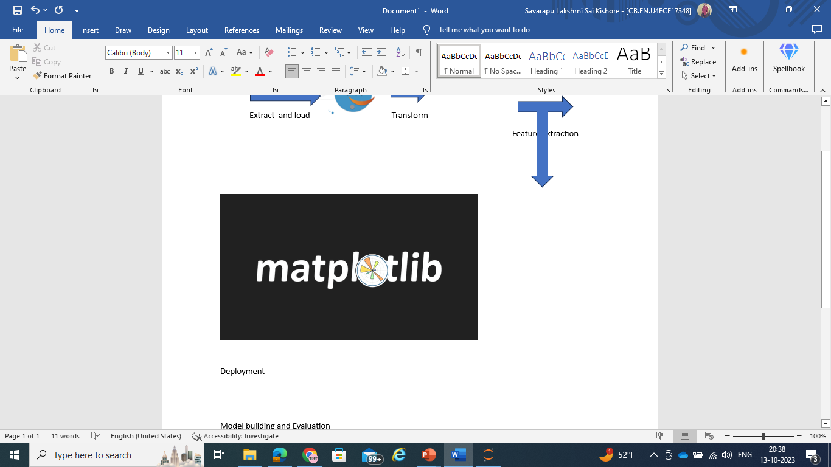


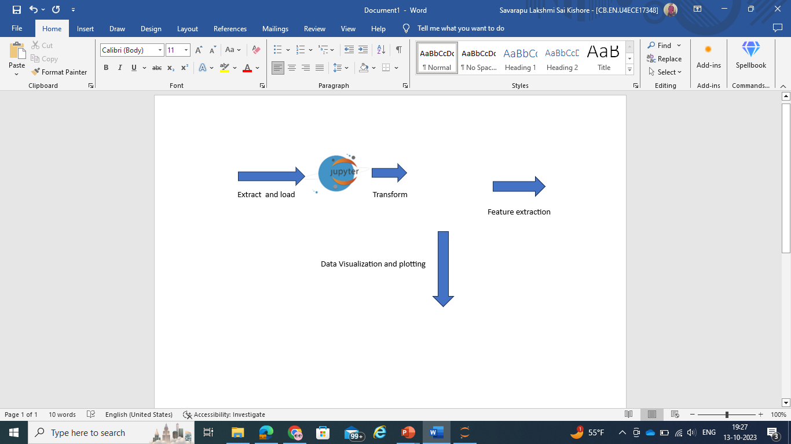
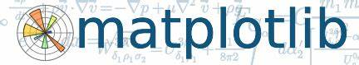
GRAPHICAL VIEW OF THE Proposed MODEL

Slide 8

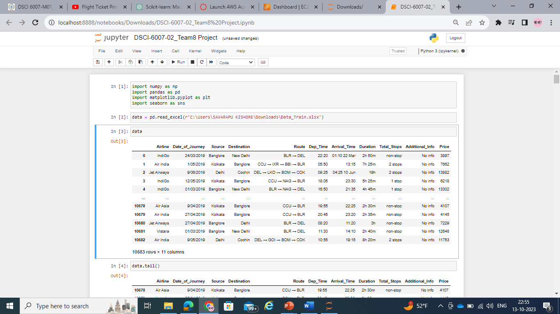
Dataset from Kaggle
https://www.kaggle.com/datasets/nikhilmittal/flight-fare-prediction-mh
Volume: 10683 samples of data
Variety: Structured Data
Velocity: Data generated during the pre covid period
Veracity: Kaggle is said to be the trusted go to point of information
Value: Data can be used to estimate domestic flight fares in India

Slide 9
Tools to be used
For team use and access, data is gathered from Kaggle and saved in a Github account (Data Storage).
The data is subsequently imported into a Jupyter Python notebook for processing (Data Ingestion).
The data is subsequently imported into a Jupyter Python notebook for processing (Data Ingestion).
Using the dataset, machine learning models are constructed and assessed.
Github and AWS are the storage locations for the model and dataset, making them accessible to data scientists, analysts, and end users (Data Consumption).
AWS is used to host the end user web application.

Slide 10


MODELS TO BE USED
The entire process uses a data engineering pipeline to guarantee flawless execution.
To make sure the appropriate set of data is gathered for the problem statement, the five Vs of data are examined.
Data preprocessing is conducted to eliminate any noise, bias, or outliers present in the dataset.
For the Machine Learning model to comprehend, feature extraction is used to convert non-numeric and categorical variables.
The dataset is used to create Random Forest Regression and Linear Regression models.
Accuracy and error calculations are used to assess models.
Models are implemented effectively.

Slide 11

References
https://youtu.be/WjLou_0YVMo?si=O_MsRoI5q4ooTXeC
https://youtu.be/46bRwRvW0PI?si=KIchjcJvDOZkfBMq
https://youtu.be/KFPX0FLhscs?si=VSFVpvoKYssh3epv

Slide 12
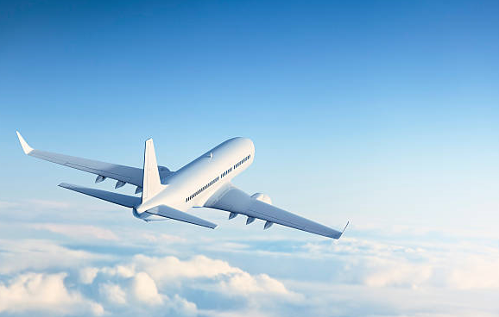
Thank You and Have a Safe Flight!

